Slide 1
SSM/VSM and ECM Integration
July, 2013

Slide 2
SSM/VSM and Contract Management
SSM (Strategic Supply Management) is the Emptoris platform that includes Contract Management.
VSM (Virtual Supply Master) is the SSM component that manages Suppliers.
Users, Groups, Organizations, and other objects needed by ECM are managed in SSM, but the separation between SSM and VSM is not always clear; e.g., to go from ECM to SSM, you click on the “Virtual Supply Master” link, then within SSM there are Administration and Virtual Supply Master tabs.
Because VSM integrates with all SSM applications (Contract Management, Sourcing, etc.) and those applications sometimes have different names for the same things, objects in VSM may have different names vs. ECM (as we will see).

Slide 3
Integration Comments
Supplier focus
The integration of data between VSM, SSM, and Contract Management is supplier-focused at this time.
V10 VSM and SSM terminology is Supply-focused; External Parties (so named in ECM) are called Suppliers in VSM. This doesn't change the usability of ECM for Sales, Provider Contracting, and other types of External Parties.
Category data is not fed to Contract Management at all.
Geographical Lists
State, Country lists in VSM – flow to ECM only when used in an Address record (for a Supplier or an Individual). Cannot be edited, inactivated or added to in ECM.

Slide 4
Integration Comments, cont.
User and Contact Data
Users are created and maintained in SSM.
User Groups (called Groups in SSM) are named and assigned users in SSM.
Permission groups are created in ECM. User and Permissions groups are associated with each other in Security Manager in ECM. [This is covered in another presentation.]
The functionality has had several changes over time, regarding whether users can have their ECM organization changed (now on the Applications tab of user profile):
Prior to V10, a user could be moved between organizations with little restriction, but he/she was in one organization for all Emptoris products.
In V10.0, restrictions were applied that allowed users to only be moved to the Parent, and other Children of the same Parent.
As of V10.0.1 (see also later slide), a user can be in a different organization for each product, and his/her ECM organization can be changed without restriction. However, there can be great impact to what the user can then do and see if he/she is moved to a different organization. Such moves are not uncommon, but the administrators at the customer site who make these changes should be very familiar with the security model in order to correctly assess any such impact.

Slide 5
Integration Comments, cont.
My Company
All internal organizations (called My Company in ECM, called Organizations in SSM) are created and managed in SSM. Creation and updates are synchronized real-time to ECM.
Legal Entity for Internal Organizations defaults to No. You must edit the legal entity in ECM, to set it to Yes. Remember to select a Currency as well.
Be careful when creating Organizations. This is less flexible than previously. You can’t change an Organization’s parent, once saved.
External Parties
Whether Mastered or not, a new Supplier is immediately available to Contract Management upon creation.
For External Parties, the Primary address in the VSM record populates the Legal address role in ECM. So there is no defaulted Corporate role, and therefore the “External Primary Party Address” System Term is not populated unless you select the Corporate address type in SSM [Virtual Supply Master (at top) > Virtual Supply Master (tab) > Suppliers > Contract Management > (edit the Supplier) > Addresses tab > add or edit Address > Type = Corporate]

Slide 6
Integration Comments, cont.
Timeouts in SSM (while using ECM):
If a timeout occurs, you will get a new login screen and/or a timeout screen
Close the window(s) you were using; otherwise, you may leave a lock on a contract
Administrators (with Unlock permission) can unlock contracts by doing a search and clicking the Unlock link

Slide 7
Now, the ECM Perspective
We’ve looked at the integration between SSM / VSM and ECM
We will now take another look, more from the ECM perspective

Slide 8
Organizations / Parties
Organizations are created in SSM and propagated to ECM.
Organization updates possible in Contract Management:
Define the organization as a Legal Entity or not
Choose the Currency
Set the Time Zone
Steps:
Login to Contract Management as an Admin
Administration > Parties > My Company
Navigate to and open the Organization
Make updates and save

Slide 9
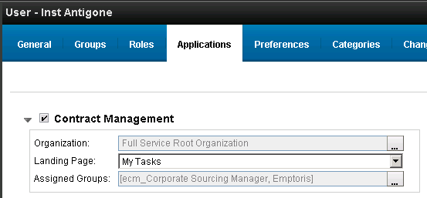
Users, Contacts, Groups
An ECM Individual (VSM: User) represents a person of interest to ECM. If the Individual was assigned a login, he/she is also known as a User.
Multiple concurrent logins can occur for one user, but can be interactions if from same client system when same browser is used (due to cookie usage, even if different windows or tabs are used)
Individuals and Users can be identified as Contacts for a contract.
User Groups (VSM: Groups) are created and assigned Users in VSM. There is no concept of Roles in ECM, unlike in Sourcing.
Each Emptoris user is created in VSM and for ECM is assigned an Organization and Group(s) on the Applications tab of the User Profile.

Slide 10
Roles
While Roles are not used in Contract Management, there are VSM roles for users, of which Administrator and Category Administrator are among the most useful in setting up VSM for ECM.
There are two VSM roles specific to ECM: “ECM Create Suppliers” and “ECM Update Suppliers”. They provide the (VSM) permissions needed for VSM tasks that were performed in ECM prior to VSM being introduced.

Slide 11
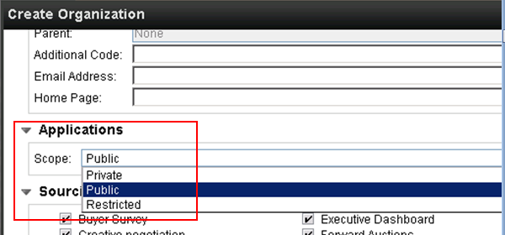
Organizations and Users as of V10.0.1
Changes were made in V10.0.1 regarding Organizations and how Users relate:
Internal Organizations have a Scope of Private, Public, or Restricted.
Private: organization is only for SSM
Public: organization is synched to all installed Emptoris SSM applications
Restricted: organization can only be used with specific SSM application(s)
A user can now be in one Organization for ECM, and different one(s) for other applications.

Slide 12
External Companies / Suppliers
External Companies in ECM can be identified as contacts in contracts. External Companies are created in VSM (or SLM: see below) as Suppliers and propagated to ECM.
Emptoris Supplier Lifecycle Management (SLM) provides the highest degree of capability for managing Suppliers, but SSM/VSM on its own provides sufficient Supplier functionality for ECM.
Suppliers can optionally be Mastered (via the Closest Matches tab in VSM record)
Mastering is the creation of a “golden record” that has been established from among possible duplicate records for the same Supplier. When a Supplier has been mastered, it has a “Master ID” in VSM and ECM.
It is not necessary to Master a Supplier for it to appear in ECM.

Slide 13
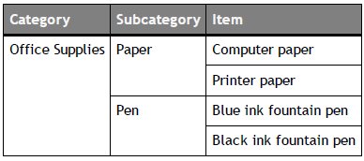
Catalog, Categories, Items
(These are of more pertinence to Sourcing, but Categories are used in ECM.)
The Catalog is a hierarchical system of the following:
Categories: high-level groupings of products to be sourced
Subcategories: children of categories
Items: the actual products
The Catalog can have an unlimited number of categories and subcategories.
The bottom level always contains items.
Categories and subcategories are managed in VSM (Categories > Master) and are normally created through batch uploads. Items are managed in Sourcing (Categories link).
Example:

Slide 14
Demonstration in VSM:
Login as Admin user
Show Organizations
Show full list of VSM Roles by looking at Admin user profile
Show Users; create one and focus on the Applications and Preferences tabs
Show Emails or Inbox (useful when email system isn’t set up, as on training system). Retrieve the initial password for the new user, log in to the new user and look around.
Show Suppliers in VSM / External Parties in ECM
Show Categories
See document “IBMEmptorisVSMHowTo_Refresher.pptx” in handouts

Slide 15
Integrated Data – SSM to ECM
We now return (for Reference only) to the integration of SSM/VSM and ECM.
The following slides show naming differences and other considerations related to the integration of SSM and ECM.
The slides were correct as of V10.0. There may be a few changes in V10.0.1 not reflected here.

Slide 16
Integrated Data - Individual
SSM Field Name | ECM Field Name | Comments
User Info
First Name | First Name
Middle Name | Middle Name
Last Name | Last Name
Type | Company (Mine, External, None) | Derived from Company (Mine) and User Account
Username | Username
Organization | Organization
Manager | Manager
Phone | Primary phone
Email | Email
Address | Address | Map from Addresses defined
Language | Display Language | From preferences tab in SSM
DERIVED | Locale | From preferences tab in SSM (based on date and number formats; see Admin Guide Appendix A)
DERIVED | Effective Start Date | When the record gets created
DERIVED | Effective End Date | When the record is deleted or disabled for ECM
DERIVED | Created | When the record gets created
DERIVED | Last Modified | When the record was last updated
DERIVED | Aliases | Also available in ECM for alias management
DERIVED | Password | Valid or expired based on the password status
DERIVED | Suppress Task Notification to user | Send an e-mail when a new inbox item arrives
User Status | Login Status | Enabled only when user is enabled for ECM application

Slide 17
Integrated Data – External Company
Field Name in SSM | Contract Management
Supplier Details | External Company
Company Name | Name
Master ID | Master ID
VSM ID | Unique ID
Master record | Is Primary
Website | Web site
Email Address | Email
Main Phone Number | Primary Phone
Primary NAICS | NAICS/SIC Code
External ID 3 | External ID
Legal Address
Address Line 1 | Street 1
Street 2 | Street 2
City | City
State | State
Country | Country
Postal Code | Postal Code
Field Name in SSM | Contract Management
POAddress
P.O. Box | Street 1
P.O. Box ZIP | Postal Code
P.O. Box city | City
Primary Contact
First Name | First Name
Middle Name | Middle Name
Last Name | Last Name
Organization | Organization
Phone | Primary Phone
Email | Email
External Identifiers
Federal Tax ID | Federal Tax ID
DUNS Number | Duns number

Slide 18
Integrated Data – Address and Phone
Label in SSM | ECM Field Name | Comments
Phone Numbers
Phone | Primary phone
NA | Phones by Phone Types | Only 2 types of phones created - Main from Phone & Fax from Fax
Street Address
Primary Address | Legal Address (role) | Note: the Corporate Address role is NOT automatically assigned.
PO Address | PO Address (role)

Slide 19
Integrated Data – Internal Organization
Label in SSM | ECM Field Name | Comments
Code | Number
Name | Name
Parent | Parent organization
Email Address | Email
NA | Legal entity | Editable in ECM; new orgs are sync'ed as non-legal entities by default
Phone Numbers
Phone | Primary phone
Fax | Fax
Street Address
Primary | Legal
PO Box | PO Box

